Slide 1
Packet Fusion
CloudConnect

Slide 2
WHAT IS CLOUDCONNECT
One Platform. Every Stage of Your Journey - Live.
CloudConnect gives you a single, real-time view of your entire relationship. From the first solution design, through ongoing support, and growth. No more guessing. No more chasing.
01
02
03
04
DISCOVERY
CLOUDPRO
CLOUDSUPPORT
OPTIMIZATION
Solutioning
Implementation
Support
Optimization
Evaluate & Recommend
Onboarding & Setup
Case Management
Continuous Enhancement
We capture your requirements and architect the right solution before starting any configuration.
Track every milestone, task, and handoff in real time. You see exactly what's happening and when.
Open, track, and resolve support cases with full visibility into status, notes, and history.
Health checks, performance reviews, and proactive expansion planning long after go-live.

Slide 3
YOUR PORTAL
Everything in One Place — Built Around You
Your CloudConnect portal gives you a live window into your account — so you're always informed, never surprised.
Live Project Status
Support Case Tracking
See every milestone, task, and owner in real time — no status calls needed.
Every ticket open, in progress, or resolved — with full notes and history.
Scheduled Reviews & QBRs
Performance & Analytics
Your upcoming business reviews, on your calendar, with shared agendas.
KPI dashboards and usage insights that show the value you're getting.
Documents & Records
Proactive Alerts
SOWs, project plans, and reports — accessible any time, from anywhere.
Get notified before issues become problems — not after.

Slide 4
WHY IT MATTERS
What Changes When You're Always in the Loop
↓
→
↑
No more status chasing
Faster decisions
More value from day one
Your project and support status is live, visible, and always up to date without a single email.
With real data at your fingertips, you can act quickly on issues, renewals, and expansion opportunities.
Visibility into every stage means your team adopts faster, resolves issues sooner, and gets ROI quicker.

Slide 5
Cisco Solution Audit & Migration Assessment
Packet Fusions (MAT) Migration Assessment Tool
Automated Intelligence for UCaaS Migrations

Slide 6
Migration Intelligence
Audit Tool (MAT)
How PacketFusion eliminates guesswork and accelerates cloud migration
What is the MAT?
What the MAT Delivers
Automated Data Extraction Connects directly to your existing PBX (e.g. Mitel, Cisco CUCM, Avaya, NEC) and extracts full system configuration data, no manual data gathering required.
01
Detailed System Inventory Complete count and categorisation of all DNs, profiles, devices, hunt groups, call flows, trunks, and paging groups across every site.
Vendor-Agnostic Audit Captures profiles, devices, trunks, call flows, hunt groups, locations, and extension ranges regardless of legacy platform.
02
Feature Parity Analysis Side-by-side comparison of current PBX features vs. cloud platform capabilities with supported, unsupported, and check-required flags per feature.
Cloud Readiness Report Produces a structured assessment report that maps your current environment to the target cloud platform (e.g., Zoom Phone), identifying gaps and risks before migration begins.
03
Call Usage & Licensing Intelligence CDR-based analysis categorises users as High / Medium / Low usage directly informing license tier decisions and cost modelling.
04
Pre-Flagged Issue Log Automatically identifies configuration problems, duplicate DNs, short extension lengths, single-member groups, unsupported devices, that must be resolved before migration.
Migration Workbook Output Automatically generates a pre-populated migration workbook, reducing manual effort and accelerating the Discovery & Planning phase.
05
Analog & Peripheral Device Map Surfaces all fax machines, ATAs, alarm lines, and analog endpoints requiring gateway hardware critical for campus and multi-site environments.
© PacketFusion | Powered by Bridgepointe Technologies | Migration Intelligence Audit Tool

Slide 7
MAT Report Sections & Why They Matter
Each section of the audit report directly informs a critical decision in the migration planning process
01 CDR Summary & Call Usage
02 Feature Parity Analysis
03 Handset & Extension Inventory
What it captures:
What it captures:
What it captures:
Identifies High / Medium / Low users by call volume
65% parity score example flags unsupported & check-required features
Full device list: IP phones, soft clients, ATAs, analog adapters
Why it matters:
Why it matters:
Why it matters:
Directly maps to license tier selection avoids over-provisioning or under-licensing on day one.
Surfaces functional gaps before go-live, allowing time to retrain users or reconfigure workflows.
Determines which endpoints need replacing, which need gateways, and informs hardware procurement.
04 Issues & Configuration Flags
05 Call Flows, Hunt Groups & Routing
06 Migration Workbook Output
What it captures:
What it captures:
What it captures:
Auto-detects duplicate DNs, extension length violations, single-member groups
Maps all hunt groups, pickup groups, IVR routes, and pilot numbers
Auto-populated profiles, locations, hunt groups, and analog device tabs
Why it matters:
Why it matters:
Why it matters:
Problems flagged here must be resolved before import — catching them early prevents failed migrations.
Ensures call routing logic is preserved or redesigned before cutover zero disruption to users.
Eliminates weeks of manual data entry the workbook is ready to import into the cloud platform.
The MAT is included as part of PacketFusion's Discovery & Planning phase — at no additional cost to the client.

Slide 8
Sample Migration Assessment

Slide 9
Data Extraction Tool | System Overview & Executive Summary
PACKETFUSION
1. System Overview
2. Insights Summary
Cisco CUCM 10.5.2 | Audited: 2026-05-08 | IP: 172.16.0.2 | Build: 10.5.2.16900-10.i386 | Publisher MAC: 001F29BC4694
793
135
Field | Value
Organization | Customer ABC
System Type | Cisco CUCM (On-Premise PBX)
Version / Build | 10.5.2 / 10.5.2.16900-10.i386
IP Address | Publisher 172.16.0.2 | Subscriber 172.16.0.3
IP Extensions
Analog Extensions
949
952
CDR Call Activity (Real Usage Data)
Total calls: 86,827 | Incoming: 57,278 | Outgoing: 29,549
HIGH users (>100 calls): 91 | >250 calls: 67 | >1000 calls: 17
LOW users (0 calls): 325 | Under 20 calls: 296
Call Forwarding Summary
External forwards: 4 | Internal forwards: 607 extensions
⚠ 4 extensions forward to external PSTN — review before migration
Data Quality Alerts
⚠ 13 duplicate extensions detected
⚠ 16 duplicate names detected
⚠ 24 devices with no extension number assigned
⚠ 167+ legacy 7940/7960 phones (EOL — unsupported on Webex)
Total DNs
Total Devices
⚡ Energy & Carbon Footprint Insight
Infrastructure consumes 1.22 kWh (10,670 kW annually).
CO2: 5,597 kg/year | Energy cost: £4,054/year
Equivalent to felling 10.67 trees or driving 1.63 cars annually.
E3 license cost est: £16,201/mo | E5: £25,606/mo (627 active users)
🌱 Hosted cloud migration reduces carbon impact significantly.
© Packet Fusion | Powered by Bridgepointe Technologies | Data Extraction Tool

Slide 10
Data Extraction Tool | Detailed Report
PACKETFUSION
3. Detailed Insights
3.1. CDR Summary
This table provides a list of each type of facility that is in use across the existing solution.
Note: Not all items detailed are applicable to all vendors.
If CDR data is available, this will show a summary of call types and extension counts below.
Category | Count | Information
Duplicate Extns | 13 | Usually caused by both extn and profile having same DN
Duplicate names | 16 | Will occur frequently in large organisations
Duplicate MAC addresses | 0 | Usually caused by legacy programming
Pickup groups with 1 member | 0 | Redundant programming of Pickups
Total devices | 952 | Total physical devices
Total profiles | 0 | Total profiles
Total Home Cluster profiles | 0 | Total profiles marked as 'Home Cluster'
Total Non-Home Cluster profiles | 0 | Total profiles that are not marked as 'Home Cluster'
CSF devices | 0 | Total number of devices using 'Cisco Client Services Framework'
IP Communicators | 0 | Total number of 'IP Communicators'
Total Mobility | 0 | Total Mobility Users
Total DNs | 949 | Total DNs defined (Extns, Trunks, Groups, Digit Trans, Profiles etc.)
Total DNs without name | 0 | Total Directory Numbers without a name defined
Total without number | 24 | Total devices or profiles without a valid DN
Total Hunt Groups | 1 | Total Hunt Groups in use
Total Workgroups | 0 | Total Workgroups in use
Total Paging Groups | 0 | Total Paging Groups in use
Total Pickup Groups | 21 | Total Pickup Groups in use
Total Soft Phones | 0 | Total Soft Phones in use
Metric | Count
Total Extension Directory Numbers (DN's) | 627
Total Calls out for ALL DN's | 29549
Total Calls in for ALL DN's | 57278
Total number of extensions with more than 10 calls out | 263
Total number of extensions with more than 10 calls in | 332
949
0
1
Total DNs
Total Profiles
Hunt Groups
Defined in system
Home cluster
Active groups
💡 CDR-based usage categorization identifies High / Medium / Low usage users to help optimize licensing and migration planning.
© Packet Fusion | Powered by Bridgepointe Technologies | Data Extraction Tool
1

Slide 11
Data Extraction Tool | Migration Considerations & Call Usage
PACKETFUSION
3.4 Migration Considerations to Zoom
4. Migration Call Usage Considerations
zoom
If CDR data is available, this report will detail the number of users making and receiving calls across the existing solution. This allows you to understand potential licensing costs for any cloud provider in terms of the 'voice' licenses and call costs.
This table details any common facilities being used by a legacy platform and if it is supported in the Zoom hosted environment. To identify parity gaps, the audit is mapped to Zoom. There are 949 directory numbers in the audited platform.
949
86827
57278
29549
Facility in use | Active | Teams
Call Forwarding | 608 | ✓ Std feature
Cisco Phones | 785 | ⚠ Check Models
Total profiles | 0 | ✓ Std feature
Analog Phones | 159 | ⚠ Check models
Hunt Groups | 1 | ✓ Std feature
Pickup Groups | 21 | ✓ Std feature
Total DNs
Calls Made
Calls In
Outgoing
Directory Numbers
Outbound
Inbound
Calls out
LOW
MEDIUM
HIGH
✓ = Supported ✗ = Unsupported ⚠ = Limited support
Overall Feature Parity
Call Usage (if available)
62%
325 users with 0 calls
85 users with under 50 call involvements
91 users with over 100 call involvements
296 with under 20 calls
71 with under 100 call involvements
67 over 250 | 17 over 1000
Feature parity score
0 100
© Packet Fusion | Powered by Bridgepointe Technologies | Data Extraction Tool
43

Slide 12
Data Extraction Tool | Gateway Overview & Handset Summary
PACKETFUSION
6. Gateway / Cabinet Overview
7. Handset and Extension Summary
There are 9 Gateways/Cabinets in this configuration.
A summary of the extension types captured within the audit of the existing voice solution, and the capacity of the existing system if available.
Gateway name | Detail | MAC | IP Address
System / 2x Cisco 2811 / 2x VG224 / VG320 / Cisco 2851 / Subscriber / Publisher
 | Used
Total | 928
Analog | 135
Digital | 0
Hybrid (i.e. COV) | 0
IP | 793
6.1 SRST Servers
Survivable Remote Site Telephony (SRST) is a CUCM call processing backup mechanism that allows Cisco IP phones to register to a Cisco router for local communications if the main CUCM becomes inaccessible.
SRST | IP Address 1 | Port 1 | IP Address 2 | Port 2 | IP Address 3 | Port 3
Disable |  | 2000 |  | 2000 |  | 2000
Use Default Gateway / Wilshire 172.18.211.254 |  | 2000 |  | 2000 |  | 2000
7.1 Extension Number (DN) Ranges
Details the extension number ranges determined within the existing solution, and the number of extensions or users within each range. Useful for DID numbering and planning SBCs or Voice Gateway routes.
Prefix | Length | Total allocated | Start number | End number
22** | ⚠ 4 | 3 | 2202 | 2299
24** | ⚠ 5 | 3 | 2401 | 2496
28** | ✓ 3 | 2 | 2800 | 2899
25** | ✓ 3 | 1 | 2500 | 2599
⚠ There are 135 analog devices configured. Any migration to hosted voice that requires analog extensions (e.g. Fax / Modems / PDQ etc.) will require FXO/Analog Gateways at the required locations.
There were 0 extensions marked as 'out of service'
⚠ Extensions with different digit lengths can cause issues on hosted voice and should be reviewed prior to migration.
© Packet Fusion | Powered by Bridgepointe Technologies | Data Extraction Tool
44

Slide 13
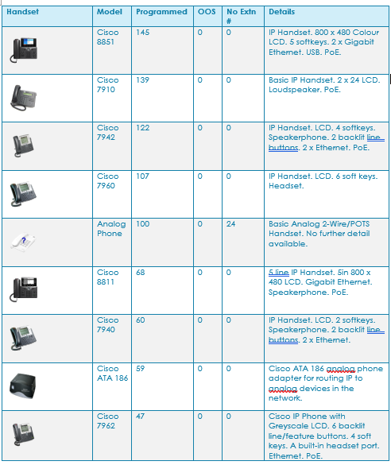
Data Extraction Tool | Handset Inventory Overview
PACKETFUSION
7.2 Handset Types
Device Summary
Where known, this details all handset / softphone types in use. This ensures migration does not reduce user experience.
785
Total Cisco IP Phones
159
Analog / POTS Phones
145
Cisco 8851 (top model)
139
Cisco 7910
122
Cisco 7942
107
Cisco 7960 ⚠ EOL
68
Cisco 8811
60
Cisco 7940 ⚠ EOL
59
Cisco ATA 186
⚠ Cisco 7940/7960 are EOL and unsupported on Webex. ATA 186 & all analog phones require FXO/analog gateways for hosted migration.
© Packet Fusion | Powered by Bridgepointe Technologies | Data Extraction Tool

Slide 14
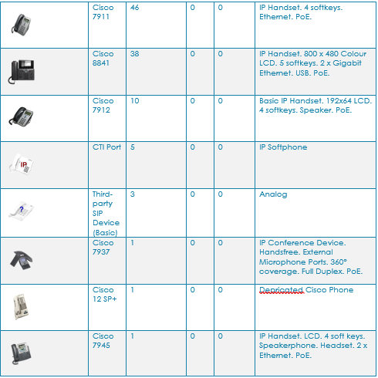
Data Extraction Tool | Handset Inventory Overview
PACKETFUSION
7.2 Handset Types Continued
Device Summary
Where known, this details all handset / softphone types in use. This ensures migration does not reduce user experience.
46
Cisco 7911 — IP Handset. 4 softkeys. PoE.
38
Cisco 8841 — 800×480 LCD. 5 softkeys. Gigabit.
10
Cisco 7912 — 192×64 LCD. 4 softkeys. PoE.
5
CTI Port — IP Softphone
3
Third-party SIP (Basic) — Analog
1
Cisco 7937 — IP Conference. 360°. Full Duplex.
1
Cisco 12 SP+ — Deprecated Cisco Phone
1
Cisco 7945 — LCD. 4 softkeys. Speakerphone.
105
Devices in this continued section
⚠ Cisco 12 SP+ is deprecated. CTI Port (5 devices) is unsupported on all cloud platforms. Third-party SIP devices require evaluation for compatibility with target hosted platform.
© Packet Fusion | Powered by Bridgepointe Technologies | Data Extraction Tool

Slide 15
Data Extraction Tool | Calling Search Spaces
PACKETFUSION
9. Calling Search Space (CSS)
CSS Detail
CSS profiles define the ordered list of partitions controlling which numbers each device can dial. These permission tiers map directly to cloud dialling plans.
CSS Name | Partitions / Scope
911test | Nationwide
Bookstack-Hotline | LibraryPartition
CampusPolice | CampusPolice (auto-dial 6625276)
CommService | Local, Inter-Switch, LATA, CommService, Phone
E911CCS | E911, Inter-Switch, LATA, Local, Nationwide, Registration, Statewide
ExchangeUM | VMPilotPartition
INFORMACAST_CSS_InHouse | INFORMACAST_PT, Inter-Switch
INFORMACAST_CSS_LATA | Inter-Switch, Local, Emergency, LATA, INFORMACAST_PT
INFORMACAST_CSS_Nationwide | Nationwide, Inter-Switch, LATA, Local, Statewide, Emergency, INFORMACAST_PT
INFORMACAST_CSS_Statewide | Statewide, Inter-Switch, LATA, Local, Emergency, INFORMACAST_PT
INFORMACAST_ICVA CallAware | Inter-Switch, Local, Emergency
InHouse | Inter-Switch
International | International, Inter-Switch, LATA, Local, Nationwide, Statewide, Emergency
LATA | LATA, Inter-Switch, Local, Emergency
Local | Local, Inter-Switch
Lot3codeblue | Lot3codeblue (auto-dial)
Nationwide | Nationwide, Inter-Switch, LATA, Local, Statewide, Emergency
NationwideE911 | Nationwide, Inter-Switch, LATA, Local, Statewide
Receiving | Receiving (auto-dial 2495)
Registration | Registration, Inter-Switch
Statewide | Statewide, Inter-Switch, LATA, Local, Emergency
21
CSS Profiles
Controlling 952 devices
Local
LATA
Statewide
Campus-only calling
Regional area codes
California codes
Nationwide
International
E911CCS
Full US dialling
Unrestricted
Emergency full access
Migration Mapping
Each CSS tier should be mapped to an equivalent hosted voice permission group:
Local / InHouse → Internal-only licence LATA → Regional calling plan
Statewide / Nationwide → Standard US licence
International → Unrestricted plan (review carefully)
E911CCS → Emergency access required for all users
Special auto-dial CSS: CampusPolice, Lot3codeblue, Receiving, Bookstack-Hotline
© Packet Fusion | Powered by Bridgepointe Technologies | Data Extraction Tool

Slide 16
Data Extraction Tool | Trunks, Call Flows & Location Information
PACKETFUSION
10. Trunks
11. Call Flows, Routing & Groups
The trunk information isn't directly necessary in order to migrate to cloud solutions but is a useful metric in order to determine existing usage and capacities.
Hunt groups and pickup groups operate in two different ways: Hunt and ACD groups find the first available member (based on rules applied), whereas Pickup groups ring all members at the same time.
Type | Total allocated
Analog | 0
Digital | 0
Hybrid (i.e. AC13/AC15/E&M) | 0
IP | 4
Category | Pilot Number | Name | # of Members | Warning
Hunt | 7015 |  | 32
Hunt | 569 | Main Hunt Group | 3
Pickup | 100-120 | 21 Pickup Groups (100-120) | 1 | Single member of group
11.1 Groups with a single member
Category | Name | Type | Member DN | Member Name
100-120 | 21 Pickup Groups (100-120) | Pickup | 30031 | Basic Phone
⚠ Pickup groups with a single member are redundant – Hunt groups with a single member may be used for diverting non-geographic or other external numbers and should be reviewed.
12. Location Information
Many systems provide a centralised call-control, with gateways to extend to remote offices. Detailed below is a summary of any location or remote users discovered.
Region ID | Region Name | Std Sets | IP Sets
0 | Default | 0 | 7
1 | Wilshire | 0 | 2
2 | Phantom | 0 | 0
3 | Shadow | 2 | 0
4 | Phantom | 0 | 0
5 | Shadow | 0 | 0
12.1 Extension ranges by location
10.1 Trunks (SIP)
Region | Extn prefix | # in range | Start | End
Default | 22** | 3 | 2202 | 2299
Default | 24** | 2 | 2401 | 2496
Default | 28** | 1 | 2800 | 377
Default | 30*** | 3 | 30030 | 30030
Shadow | 30*** | 2 | 30031 | 30032
Trunk Group | Device Pool | Description | CSS / Type
1 | INFORMACAST_DP | InformaCast #1 | SIP
2 | INFORMACAST_DP | InformaCast #2 | SIP
3 | Customer | Unity Connection VM | InHouse / SIP
4 | Voicemail | Exchange Unified Messaging | ExchangeUM / SIP
© Packet Fusion | Powered by Bridgepointe Technologies | Data Extraction Tool
46

Slide 17
Data Extraction Tool | Trunks, Call Flows & Location Information
PACKETFUSION
11. Call Flows, Routing & Groups
11.2 Translation Tables
Hunt groups and pickup groups operate in two different ways: Hunt and ACD groups find the first available member (based on rules applied), whereas Pickup groups ring all members at the same time.
Cisco CUCM uses translation patterns to manipulate digits before forwarding calls across the voice network. A translation pattern normally requires another digit analysis attempt. Translation patterns and route patterns can be used to block patterns, but the default action is to attempt call routing.
Category | Pilot Number | Name | # of Members | Warning
Hunt | 7015 |  | 32
Pickup | 100 | 100_None | 2
Pickup | 101 | 101_None | 12
Pickup | 102 | 102_None | 6
Pickup | 103 | 103_None | 0 | Empty group
Pickup | 104 | 104_None | 6
Pickup | 105 | 105_None | 4
Pickup | 106 | 106_None | 5
Pickup | 107 | 107_None | 0 | Empty group
Pickup | 108 | 108_None | 0 | Empty group
Pickup | 109 | 109_None | 0 | Empty group
Pickup | 110 | 110_None | 0 | Empty group
Pickup | 111 | 111_None | 0 | Empty group
Pickup | 112 | 112_None | 0 | Empty group
Pickup | 113 | 113_None | 0 | Empty group
Pickup | 114 | 114_None | 0 | Empty group
Pickup | 115 | 115_None | 0 | Empty group
Pickup | 116 | 116_None | 0 | Empty group
Pickup | 117 | 117_None | 0 | Empty group
Pickup | 118 | 118_None | 0 | Empty group
Pickup | 119 | 119_None | 0 | Empty group
Pattern | Description | CSS | Route Partition | Called Party Transform Mask | Called Party Prefix
 | Campus Police auto-dial. Use 3300 | LATA | CampusPolice | 3300
 | Lot 3 Auto-dial. Use 3300 | Lot3codeblue | Lot3codeblue | 3300
 | Receiving auto-dial to 2495 | LATA | Receiving | 2495
 | Bookstacks to 2395 | InHouse | LibraryPartition | 2395
#3 | Calls Non-emergency Sheriff Office x4005 | LATA |  | 4005
0 | Calls Operator on 2030 | Local |  | 2030
2639 | Calls LACC Cinema engineers on x7639 | InHouse |  | 7639
4011 | Foundation DID calls 2490 |  | Inter-Switch | 2490
4012 | ex-Public Relations DID calls Main number x4000 | InHouse |  | 4000
4014 | Main Fax Number DID Roll Over calls x4013 | Local |  | 4013
4587 | NonCredit DID for FreshDesk to call 2230 |  | Inter-Switch | 2230
4588 | NonCredit DID for FreshDesk to call 2234 |  | Inter-Switch | 2234
5222 | LACC DID calls LACC FreshCaller (323-766-6240) | LATA |  | 913237666240
7116 | Calls Wesley`s Call Center (866-733-5924) | LATA |  | 918667335924
9.911 | Sheriff DID calls 2911 | LATA |  | 2911
9.911 | InformaCast CallAware 9.911 |  | INFORMACAST_ICVA-Redirect1-CA | 2911
911 | InformaCast CallAware 911 |  | INFORMACAST_ICVA-Redirect1-CA | 2911
911 | Sheriff DID calls 2911 | LATA |  | 2911
© Packet Fusion | Powered by Bridgepointe Technologies | Data Extraction Tool
46

Slide 18
Data Extraction Tool | Trunks, Call Flows & Location Information
PACKETFUSION
12.1 Extension ranges by location
12. Location Information
Much like the previous list of extension ranges, this shows which extension numbers are being used, but in this case, broken down by region or location.
Many systems provide a centralized call-control, with gateways to extend to remote offices. Detailed below is a summary of any location or remote users discovered.
Region | Extn prefix | Total # in range | Range start | Range end
Default | 22** | 72 | 2202 | 2299
Default | 24** | 71 | 2401 | 2496
Default | 28** | 69 | 2800 | 2899
Default | 25** | 62 | 2500 | 2599
Default | 20** | 62 | 2001 | 2099
Default | 23** | 55 | 2300 | 2399
Default | 26** | 53 | 2600 | 2696
Default | 33** | 53 | 3300 | 3352
Default | 27** | 52 | 2700 | 2799
Default | 29** | 50 | 2902 | 2992
Default | 21** | 42 | 2103 | 2198
Default | 59** | 26 | 5900 | 5993
Default | 12** | 22 | 1230 | 1293
Default | 15** | 22 | 1500 | 1599
Default | 17** | 20 | 1701 | 1799
Default | 14** | 19 | 1400 | 1498
Default | 30** | 18 | 3000 | 3099
Default | 13** | 17 | 1301 | 1399
Default | 39** | 16 | 3924 | 3948
Default | 18** | 15 | 1803 | 1864
Default | 35** | 14 | 3500 | 3596
Default | 75** | 10 | 7510 | 7524
Default | 50** | 8 | 5036 | 5070
Default | 56** | 8 | 5605 | 5683
Default | 10** | 7 | 1031 | 1086
Default | 11** | 6 | 1141 | 1199
Default | 51** | 6 | 5105 | 5171
Default | 40** | 5 | 4002 | 4010
Default | 45** | 5 | 4582 | 4598
Default | 34** | 5 | 3440 | 3445
Default | 31** | 5 | 3171 | 3175
Default | 78** | 5 | 7830 | 7836
Default | 70** | 5 | 7061 | 7065
Default | 73** | 4 | 7380 | 7383
Default | 54** | 4 | 5404 | 5486
Default | 57** | 4 | 5725 | 5751
Default | 19** | 4 | 1922 | 1952
Default | 41** | 3 | 4195 | 4199
Default | 52** | 1 | 5220 | 5220
Default | 32** | 1 | 3299 | 3299
Default | 16** | 1 | 1602 | 1602
Default | 74** | 1 | 7448 | 7448
Region ID | Region Name | Std Sets | IP Sets
0 | Default | 0 | 7
1 | Wilshire | 0 | 2
2 | Phantom | 0 | 0
3 | Shadow | 2 | 0
4 | Phantom | 0 | 0
5 | Shadow | 0 | 0
© Packet Fusion | Powered by Bridgepointe Technologies | Data Extraction Tool
46

Slide 19
Data Extraction Tool | Trunks, Calling Search Spaces & Migration Readiness
PACKETFUSION
13. Calling Search Spaces (CSS)
Migration Readiness Summary
20 CSS profiles controlling dialling permissions across the network.
Local — Local office codes only
LATA — Adjacent nearby area codes
Statewide — California area codes only
Nationwide — Unrestricted national dialling
International — Unrestricted dialling (all partitions)
E911CCS — Emergency 911 full access
INFORMACAST_CSS — 4 variants: InHouse / LATA / Statewide / Nationwide
Special: CampusPolice, Lot3codeblue, Receiving, Bookstack-Hotline auto-dial
Facility | Count | Status
Cisco Phones | 785 | Supported
Call Forwarding | 608 | Supported
Pickup Groups | 21 | Supported
Hunt Groups | 1 | Supported
Analog Phones (FXO gateway req.) | 159 | Review
Legacy 7940/7960 phones (EOL) | 167+ | Refresh
CTI Devices | 5 | Not Supported
CDR-Based User Tiering
Actual call data (627 active extensions) enables right-sized licensing.
HIGH (>100 calls): 91 users — full UC licence recommended
MEDIUM (50–100 calls): 71 users — standard voice licence
LOW (<20 calls): 621 users — basic licence or shared device
CDR tiering optimises cloud spend — avoid over-licensing low-activity users.
© Packet Fusion | Powered by Bridgepointe Technologies | Data Extraction Tool

Slide 20
Migration Overview

Slide 21
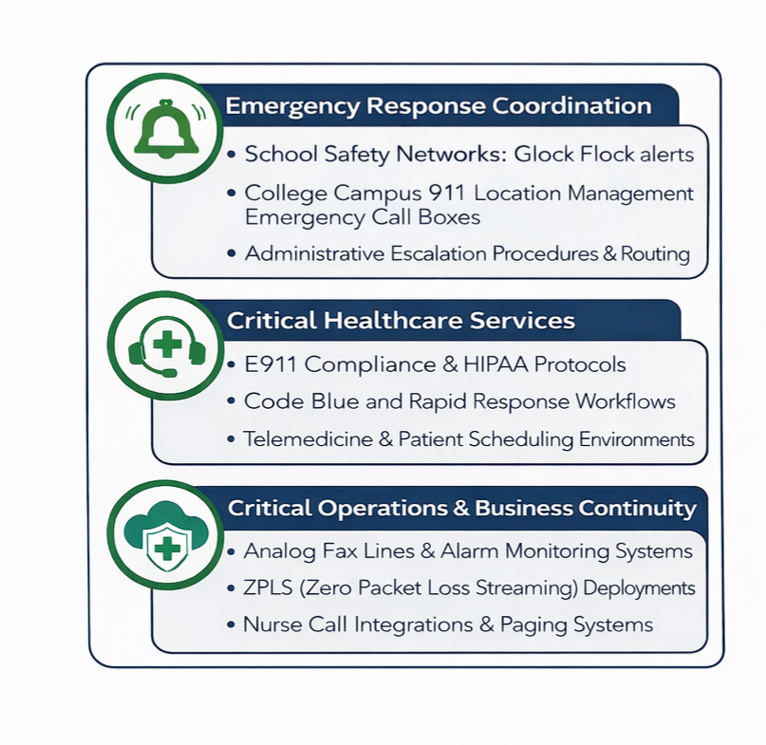
Experience Matters!
Avg. 28 Years Experience with CPE / VoIP / UCaaS Implementations
Extensive Expertise in Large Multi Building Environment Deployments
Understanding the Importance of E911 and Analog Peripherals
Recognizing the Critical Role of Readiness Assessments (VoIP & Wi-Fi) and Applying Best Practices
Direct Experience Implementing Survivability (ZPLS & Network Based)
Notes:
Avg. 28 Years Experience with CPE / VoIP / UCaaS Implementations
• Leadership across global, multi-thousand user enterprise migrations
• Complex legacy to cloud transformations spanning multiple regions and business units
• Executive stakeholder alignment and large-scale change management execution
Extensive Expertise in Large Building Environment Deployments
• Multi-building and geographically dispersed enterprise-sized campus rollouts
• High-density user design with scalable MDF / IDF architecture strategy
• Enterprise VLAN segmentation, QoS enforcement, traffic prioritization, and redundancy modeling
• Phased migration strategies minimizing downtime across thousands of endpoints
Understanding the Importance of E911 and Analog Peripherals
• Enterprise-wide E911 compliance strategy with granular location mapping and validation
• Integration of elevators, paging systems, alarms, fax, security lines, and specialty analog devices at scale
• Alignment with corporate risk, safety, and regulatory governance requirements
Recognizing the Critical Role of Readiness Assessments (VoIP & Wi-Fi) and Applying Best Practices
• Enterprise-scale VoIP and wireless readiness assessments across multiple campuses
• Network capacity modeling, latency and jitter benchmarking, and RF density validation
• Pre-deployment remediation planning to support high concurrency voice environments
Direct Experience Implementing Survivability (ZPLS & Network Based)
• Enterprise Zoom Phone Local Survivability (ZPLS) architecture for distributed sites
• Network-based survivability across redundant WAN and SD-WAN environments
• High-availability call routing, site isolation planning, and business continuity testing

Slide 22
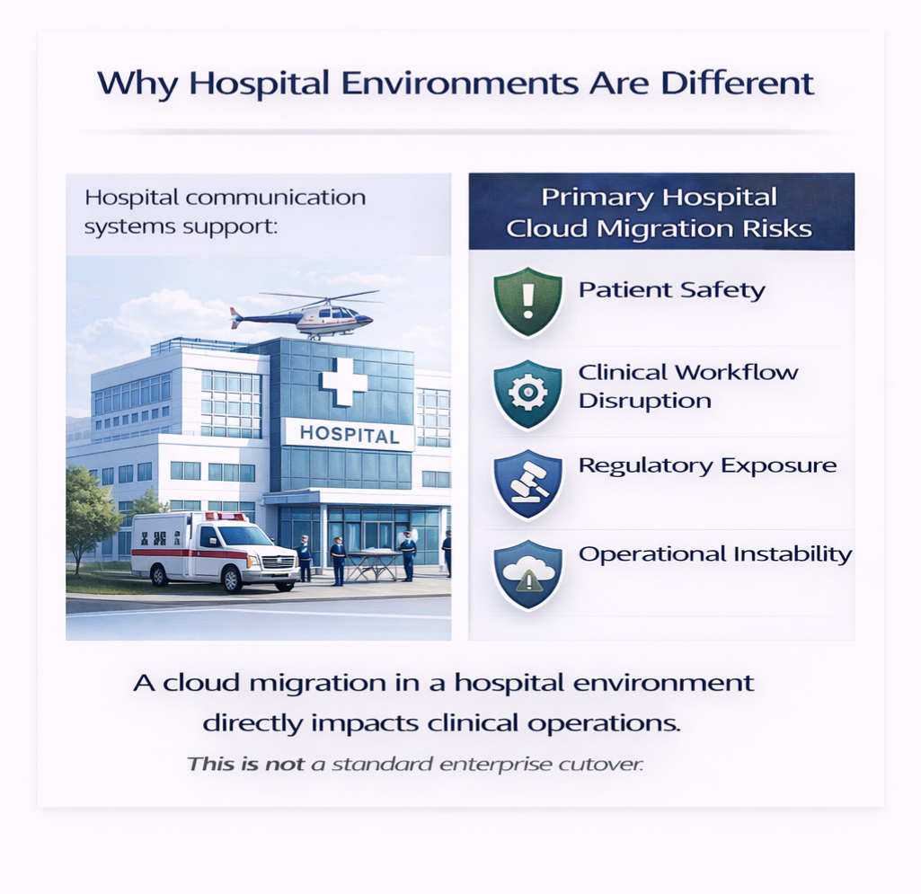
Why Hospital Migrations Are Different
Hospital communication systems support:
    Code Blue & rapid response teams
    On-call physician escalation
    Nurse station routing
    Telehealth services
    Patient scheduling & referral intake
    E911 life-safety compliance
A cloud migration in a hospital environment directly impacts clinical operations
This is not a standard enterprise cutover
Notes:
Our project management methodology approach is structured around proven processes to ensure a smooth and successful UCaaS deployment.
And since we have extensive experience working with college campuses, we understand that timing, communication, and alignment matter just as much as the technology itself.
And at each stage through the project, we focus on clear communication, detailed planning, paying close attention to critical milestones (*), and collaboration with your team to ensure every decision – supports your campus's goals and timeline.

Slide 23
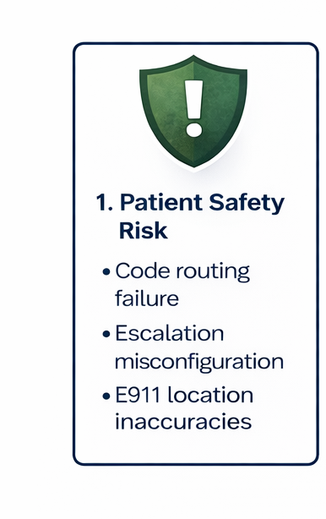
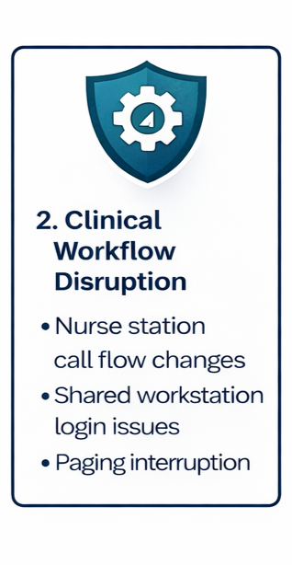
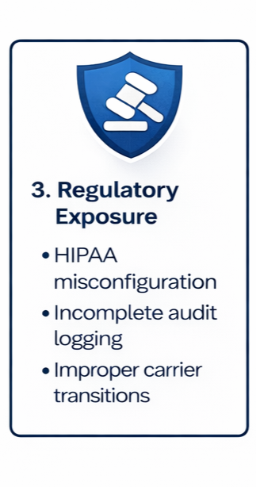
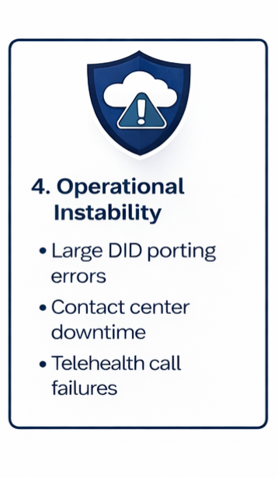
Primary Hospital Migration Risks
Notes:
Our project management methodology approach is structured around proven processes to ensure a smooth and successful UCaaS deployment.
And since we have extensive experience working with college campuses, we understand that timing, communication, and alignment matter just as much as the technology itself.
And at each stage through the project, we focus on clear communication, detailed planning, paying close attention to critical milestones (*), and collaboration with your team to ensure every decision – supports your campus's goals and timeline.

Slide 24
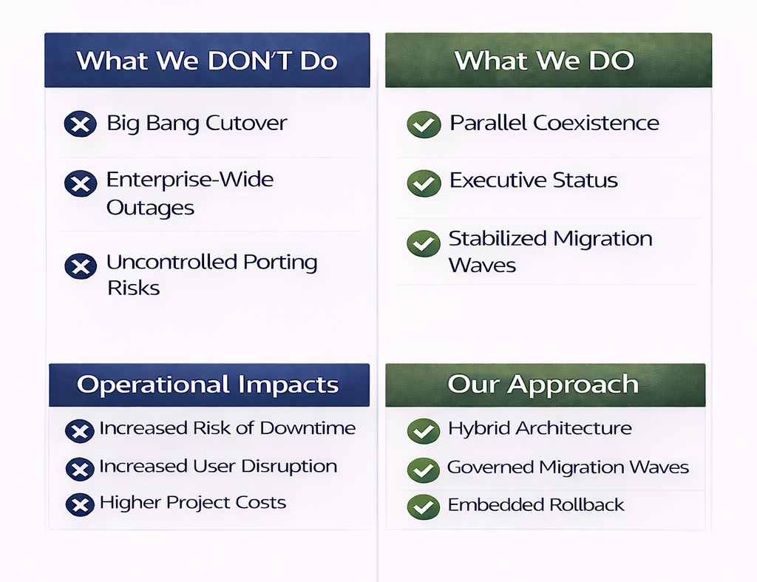
Migration Philosophy
Migration Philosophy
No “Big Bang” Cutover
Parallel Cisco + New Zoom Instance
Phased Migration with Controlled User Waves
Formal Governance and Executive Checkpoints
Operation Continuity Prioritized at Every Stage
Risk Contained by Architecture and Process
Notes:
Our project management methodology approach is structured around proven processes to ensure a smooth and successful UCaaS deployment.
And since we have extensive experience working with college campuses, we understand that timing, communication, and alignment matter just as much as the technology itself.
And at each stage through the project, we focus on clear communication, detailed planning, paying close attention to critical milestones (*), and collaboration with your team to ensure every decision – supports your campus's goals and timeline.

Slide 25
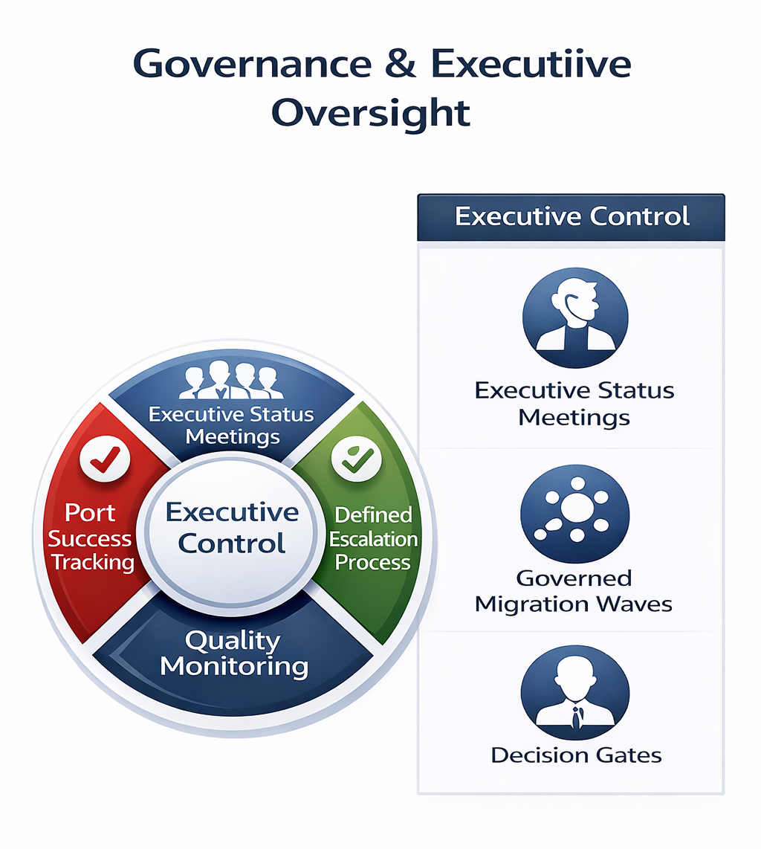
Governance & Executive Oversight
Controlled, Measurable Execution
Dedicated Program & Project Management
Executive Status Meetings
Porting Accuracy Tracking
Defined Escalation Framework
Documented User Acceptance Testing
Formal Go / No-Go Approval before each Wave
Notes:
Our project management methodology approach is structured around proven processes to ensure a smooth and successful UCaaS deployment.
And since we have extensive experience working with college campuses, we understand that timing, communication, and alignment matter just as much as the technology itself.
And at each stage through the project, we focus on clear communication, detailed planning, paying close attention to critical milestones (*), and collaboration with your team to ensure every decision – supports your campus's goals and timeline.

Slide 26
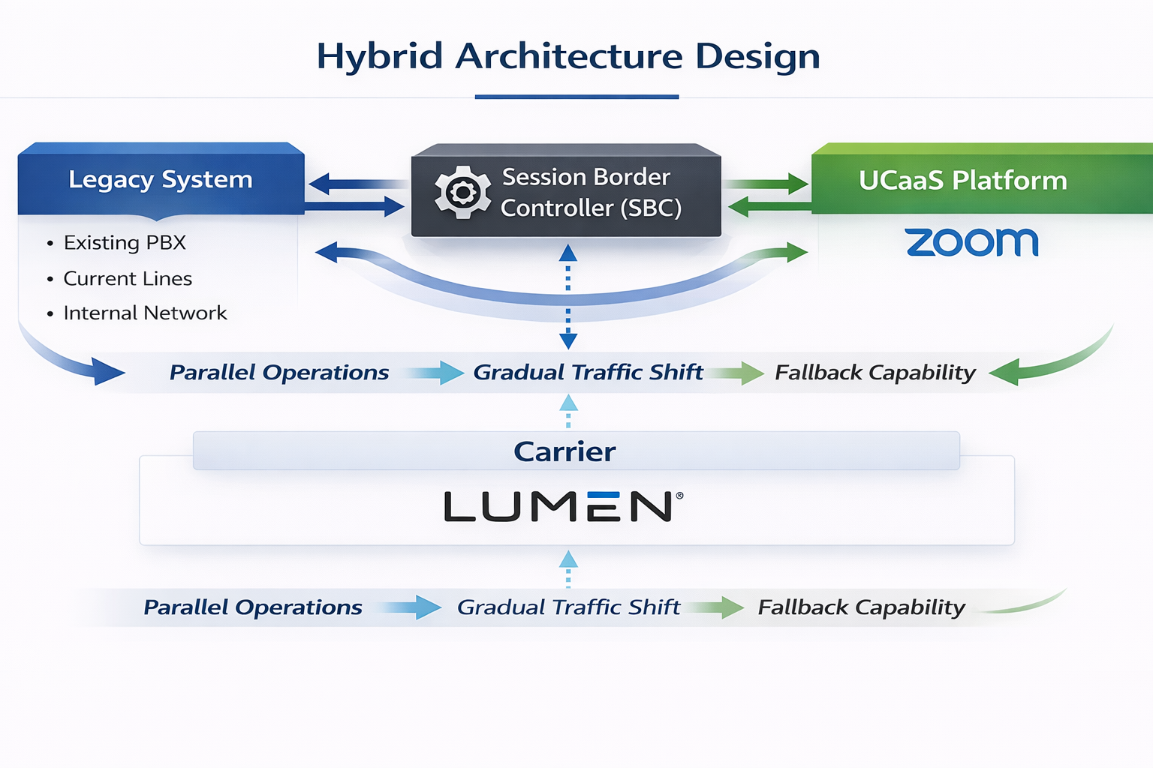
Parallel Operations Model
Hybrid Architecture Design
Dual-Platform Coexistence during Migration
Internal Dialing Continuity Preserved
Gradual Service Redirection
Failback Capability per Migration Wave
Compliance and E911 validation Built-In
No Enterprise-Wide Outage Scenario
Notes:
Our project management methodology approach is structured around proven processes to ensure a smooth and successful UCaaS deployment.
And since we have extensive experience working with college campuses, we understand that timing, communication, and alignment matter just as much as the technology itself.
And at each stage through the project, we focus on clear communication, detailed planning, paying close attention to critical milestones (*), and collaboration with your team to ensure every decision – supports your campus's goals and timeline.

Slide 27
Packet Fusion Migration
Methodology
Phase 1
Phase 2
Phase 3
Phase 4
Phase 5
Kick Off
Discovery & Planning
Pilot Migration
Migration & Porting Waves
Decommission & Optimization
Kick Off
Design & Build
Project Kick-Off *
Implementation Plan
Resource Allocation
Obtain CSR's
Port List Validation
Awareness Outreach
Packet Fusion MAT
DID Inventory
Network Assessment
Stakeholder Meetings
Tenant Invitation
Database Freeze *
Call Flow Design
Site Survey
SBC Integration
Dial Plan Normalization
Zoom Tenant Config
Configure Users
Configure Call Flow
Configure Route Points
Configure Hunt Groups
UAT *
Schedule Pilot Go-Live
Pilot User Training *
Go-Live Support Plan
Notify Users
Weekly or Bi-Weekly Cadance
Deploy Phones
Peripheral Devices
Hypercare after each wave
Post Go-Live Review
Client Success & Support Transition
Retire CUCM clusters
Remove legacy trunks
Reduce infrastructure footprint
Notes:
Structured 5-Phase Framework
Discovery & Strategic Planning
Architecture Design & Hybrid Build
Pilot Migration
Structured Migration Waves
Legacy Decommission & Optimization
Each phase includes validation gates
Each phase reduces risk before scaling

Slide 28
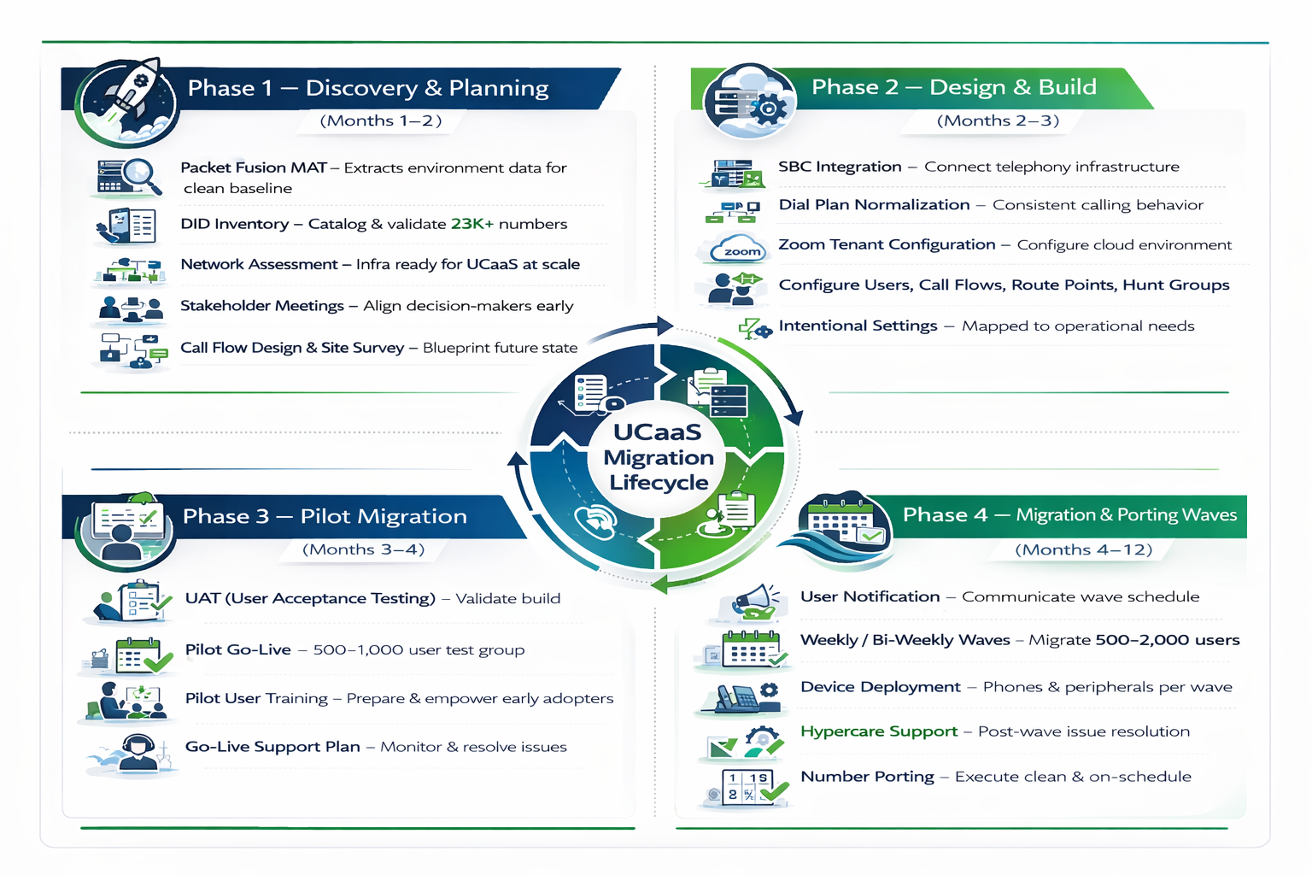
UCaaS Migration Roadmap
Notes:
Structured 5-Phase Framework
Discovery & Strategic Planning
Architecture Design & Hybrid Build
Pilot Migration
Structured Migration Waves
Legacy Decommission & Optimization
Each phase includes validation gates
Each phase reduces risk before scaling

Slide 29
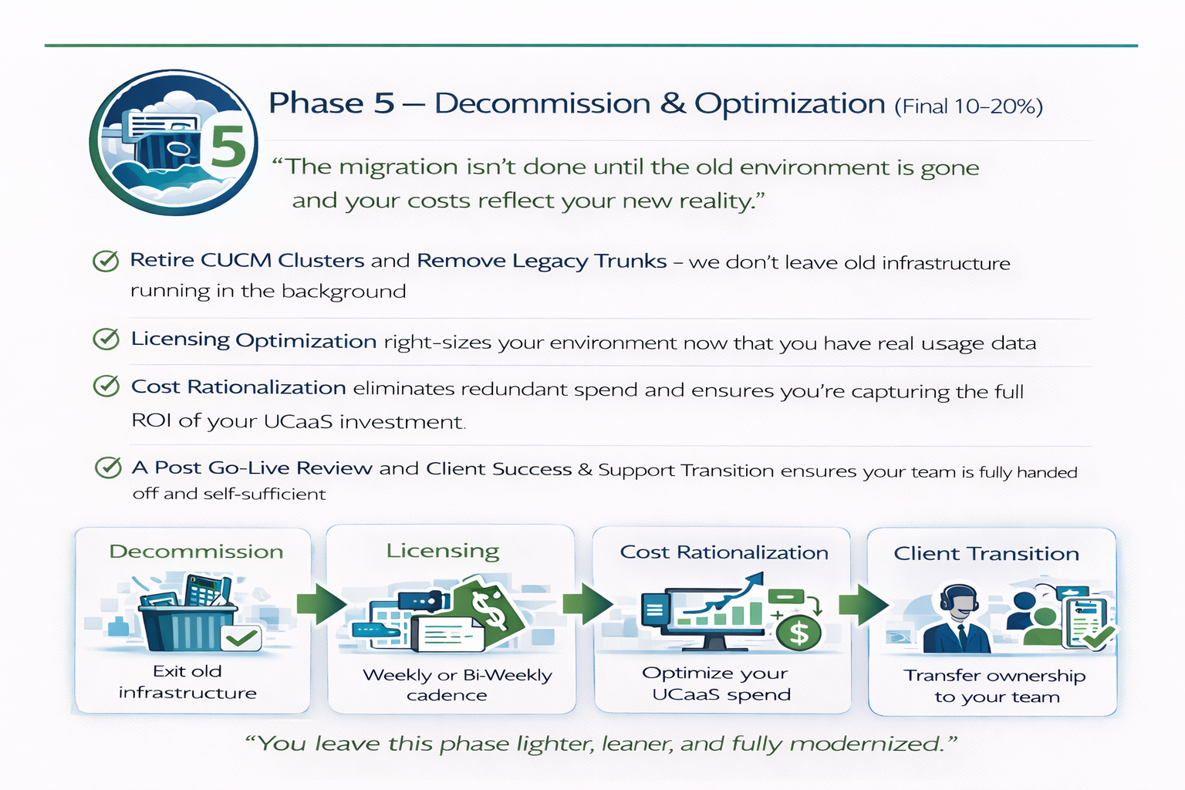
Notes:
Structured 5-Phase Framework
Discovery & Strategic Planning
Architecture Design & Hybrid Build
Pilot Migration
Structured Migration Waves
Legacy Decommission & Optimization
Each phase includes validation gates
Each phase reduces risk before scaling

Slide 30


Packet Fusion Change Control Methodology
Request Scope Change
1
Document & Complete Request
6
2
Impact Analysis
Test & Validate Request
5
3
Approve / Reject Change Request
4
Implement Scope Change
Notes:
At Packet Fusion we have implemented a change control process following PMI's methodology.
As part of initial CO (Change Order) Packet Fusion will identify the following:
CO request Identification – project stakeholders can propose a change request, and Packet Fusions PM will document the project change.
Impact Analysis and Summary – the project team analyzes the proposed change to assess its potential impact on project scope, schedule, cost, and other relevant areas.
Implement CO - The approved change is incorporated into the project plan, schedule, and other relevant documentation.
Test & Validation – Once implemented the project team will test and validate request with appropriate users.
Documentation - All change requests, their evaluation, approvals, and testing output are documented within the projects SharePoint.

Slide 31
Site Survey & Assessments
Analog Device Tone & Tag Survey
Purpose: Inventory and identify analog devices across the campus.
Tag and trace all analog fax machines, overhead paging systems, bells, clocks, and other legacy devices.
Confirm endpoint locations, jack usage, and demarcation points.
Document for Zoom analog gateway planning and cutover coordination
Network & VoIP Readiness Assessment
Purpose: Evaluate network infrastructure for Zoom Phone readiness.
Perform Zoom VOIP Readiness Assessment
Validate LAN switch configuration, VLANs, QoS tagging, and Power over Ethernet (PoE).
Assess circuit bandwidth, jitter, latency, and packet loss.
Review firewall and security appliances for SIP and media flow compliance.
Identify any legacy bottlenecks or hardware upgrades needed.
WiFi Assessment
Purpose: Ensure wireless infrastructure supports Zoom softphone and mobile app usage.
Perform a heatmap assessment of Wi-Fi signal strength and roaming performance.
Identify dead zones or oversaturated access points.
Test Zoom mobile client performance across various indoor and outdoor learning areas.
Provide recommendations for AP placement optimization if necessary.
Deliverables
Upon completion of the onsite prefield, Packet Fusion will deliver a consolidated findings report including:
A comprehensive Analog Device Map with tagging details.
A Network Readiness Report with actionable recommendations.
A Wi-Fi Coverage Analysis tailored for UCaaS support.
Overall readiness summary and risk mitigation plan for your Zoom Phone rollout.
Notes:
As previously mentioned, we have built site surveys and assessments into an initial phase unto itself, this allows for efficient and accelerated completion.
The overall effort will have three dedicated teams focused on the following:
Site Surveys which include; Tone & Tag, Auditing existing Analog connections, documenting end point locations, jack usage, demarcation points.
Wi-Fi Assessment which includes; heatmap assessment of signal strength and roaming performance along with identifying dead zones or oversaturated APs.
VoIP Assessment which includes; validation of LAN switch configuration, VLAN's, QoS, and POE. Access circuit detail (bandwidth, jitter, latency, etc. Review firewall and security appliances for SIP and Media flow. Lastly identify any legacy issues or hardware upgrade recommendations.

Slide 32
End User Training
On Site
(Desktop Features & Functionality of Phone)
1 Hr. sessions
15-20 users
Client and Mobile
Physical Phone Overview
Virtual
(Desktop Features & Functionality of Phone)
1 Hr. sessions
Capacity up to 250
Client and Mobile
Physical Phone Overview
Record for Future Reference
Train The Trainer
(Desktop Features & Functionality of Phone)
Specialist Tech / Admin Groups
Client and Mobile
Physical Phone Overview
Focus on T-the-T Content
Self-Paced
(Zoom Provided Self-Paced Training Videos and User Guides)
Zoom Self Paced Training Link
Notes:
To support the district in adopting the new Zoom platform, we offer four flexible training options: On Site, Virtual, Train the Trainer, Self Paced.
We have outlined aspects of type of training session for you review.

Slide 33
Packet Fusion Recommended Training Plan
Our strong recommendation is Virtual Training — it offers the best balance of structure and flexibility, allowing your staff to engage with the material without disrupting their day-to-day responsibilities.
We additionally recommend Virtual Train-the-Trainer sessions, as it allows for hands-on learning, real-time Q&A, and stronger knowledge transfer — ensuring your internal champions are fully equipped to confidently train and support their own teams in the future.
Virtual Administrative Training, tailored to your solution and requirements.
Virtual
(Desktop Features & Functionality of Phone)
1 Hr. sessions
Capacity up to 250
Client and Mobile
Physical Phone Overview
Record for Future Reference
Virtual Train The Trainer
(Desktop Features & Functionality of Phone)
Specialist Tech / Admin Groups
Client and Mobile
Physical Phone Overview
Focus on T-the-T Content
Virtual Admin Training
(Leveraging Your Own Portal and Tailored to Your Needs)
Specialist Tech / Admin Groups
Client and Mobile
Physical Phone Overview
Focus on day-to-day administrative activities

Slide 34

So, what does this mean for you?
Picking the right solution is only part of the equation!
Picking the right partner makes all the difference in the world!!!
We partner with you throughout the implementation and ongoing support.
We are an extension of your team.

Slide 35

Q & A

Slide 36
Design Overview

Slide 37
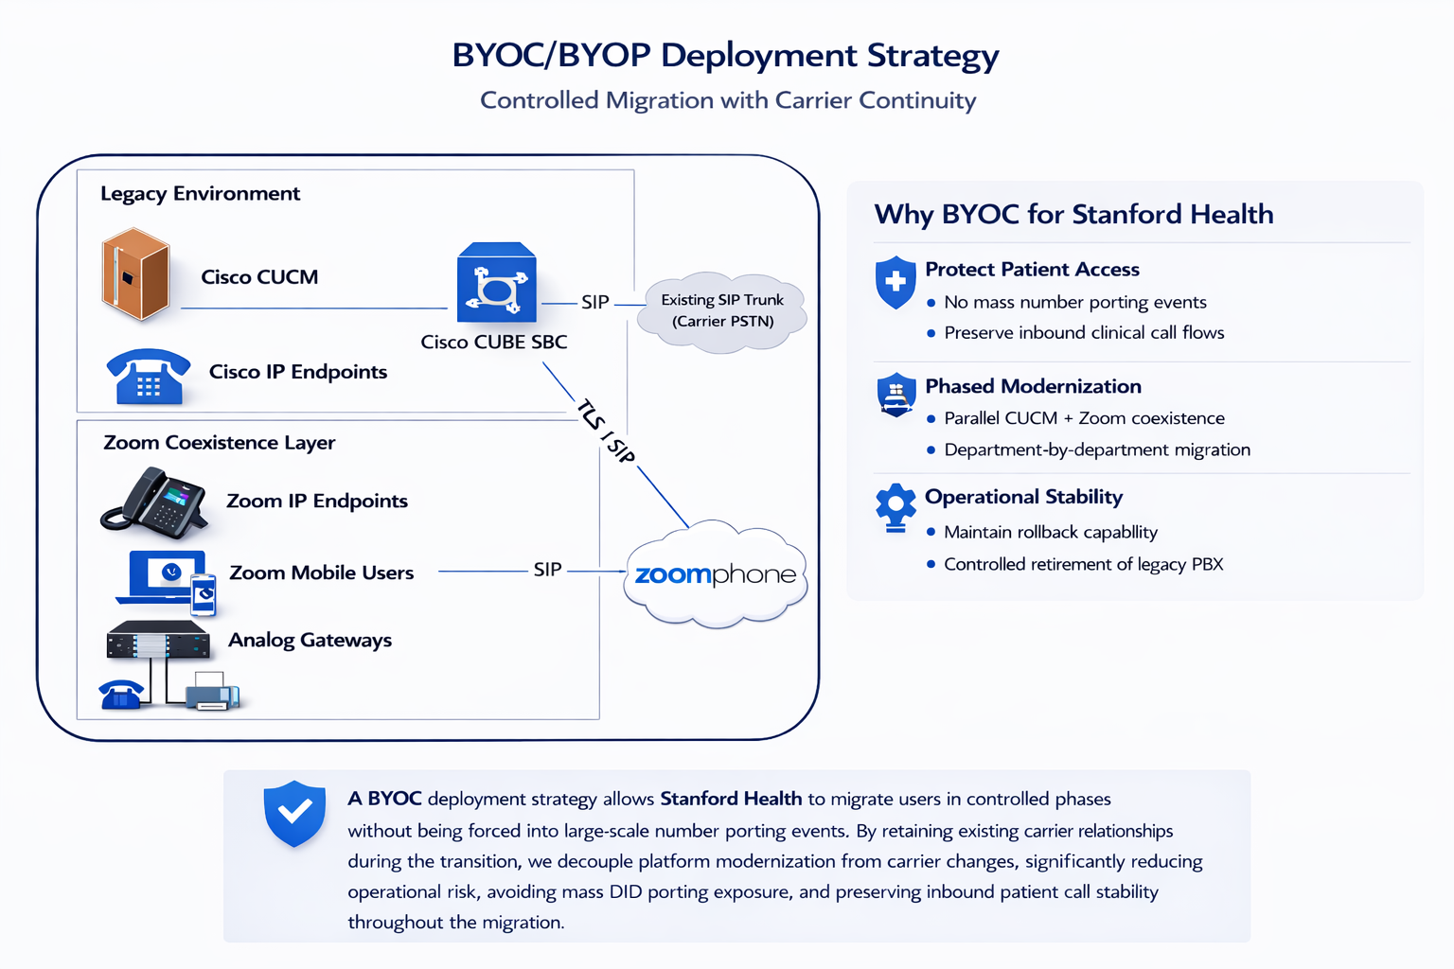

Slide 38
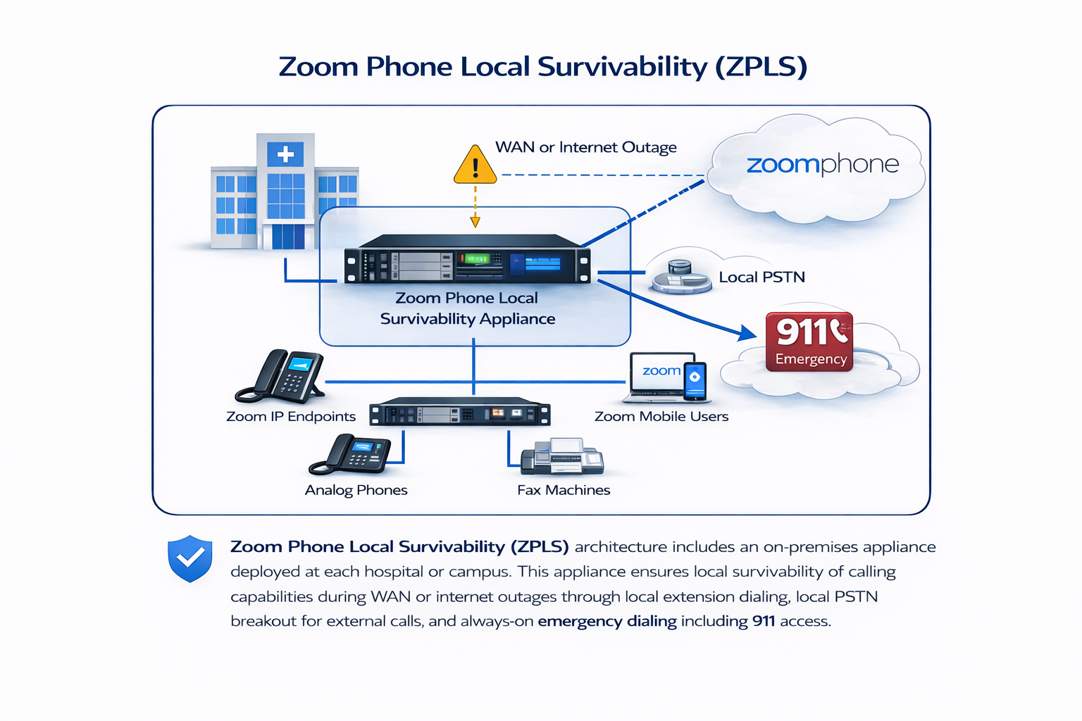

Slide 39
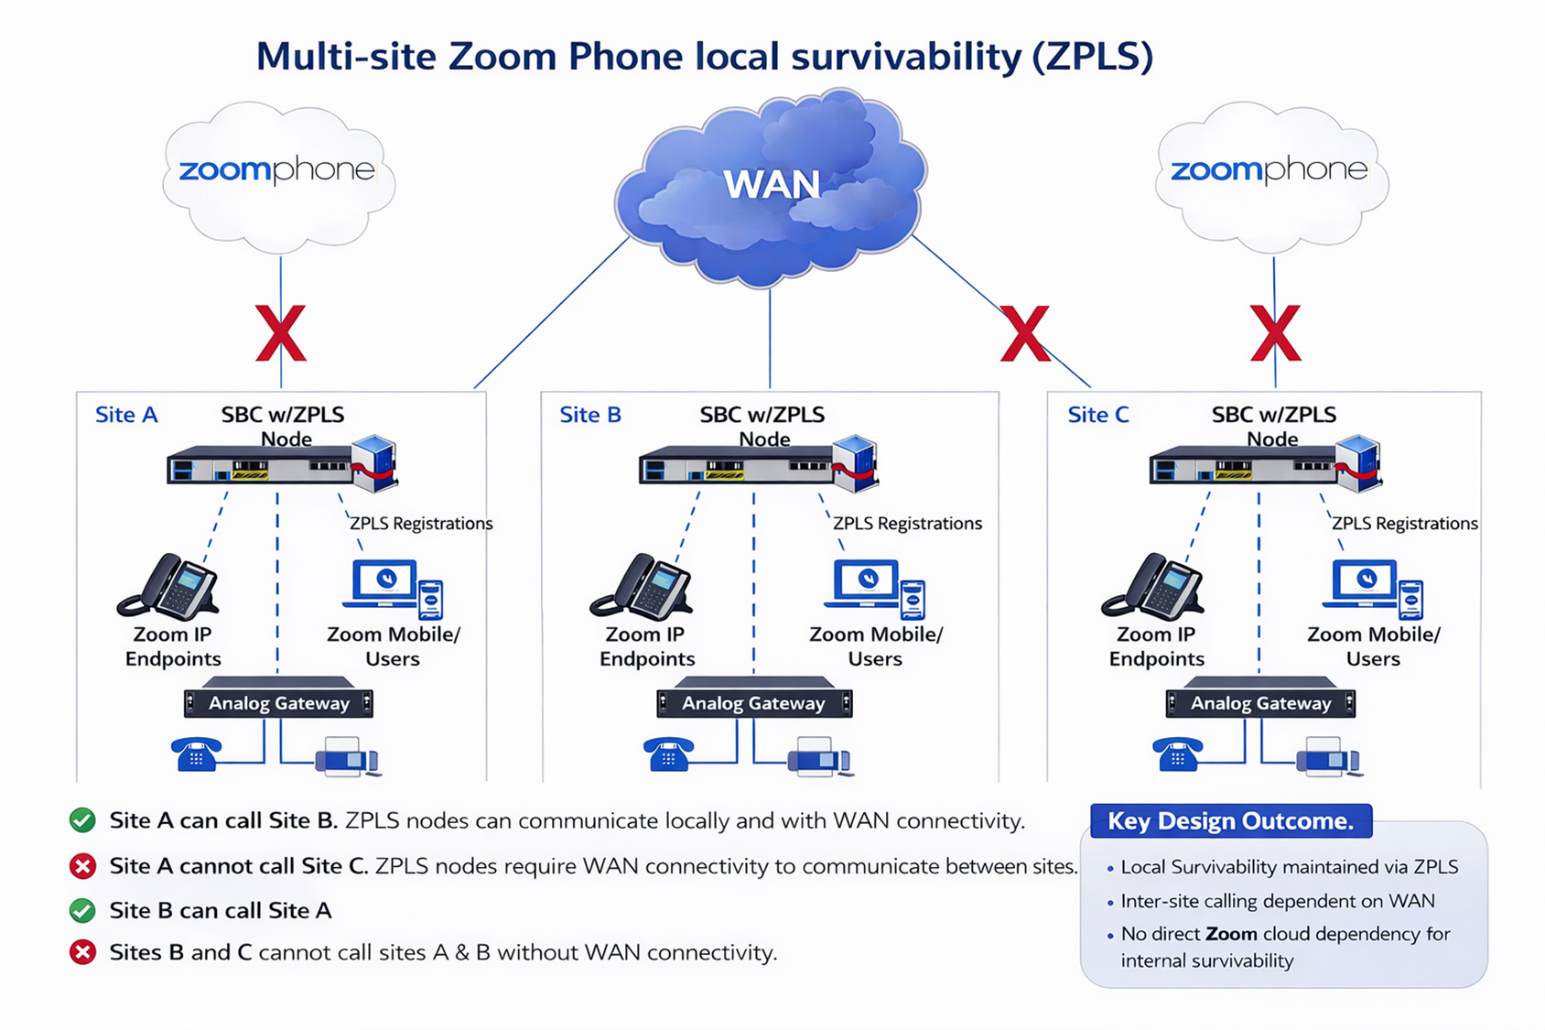

Slide 40
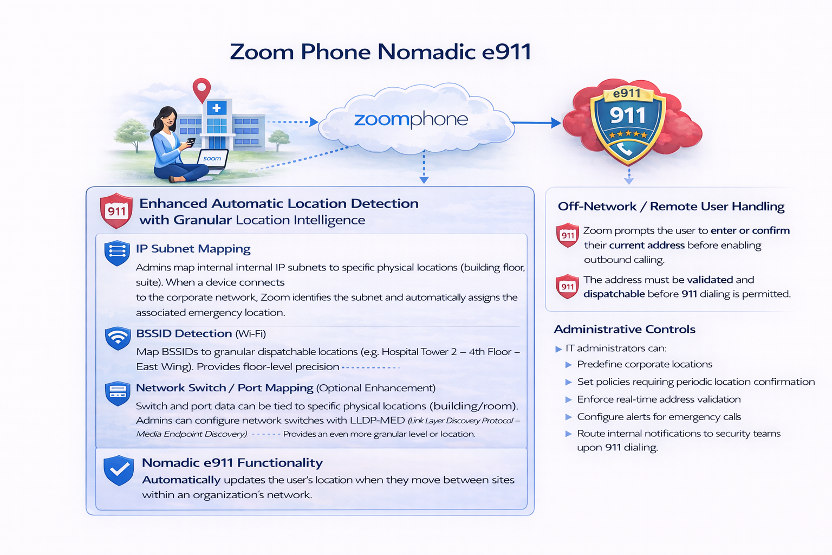

Slide 41
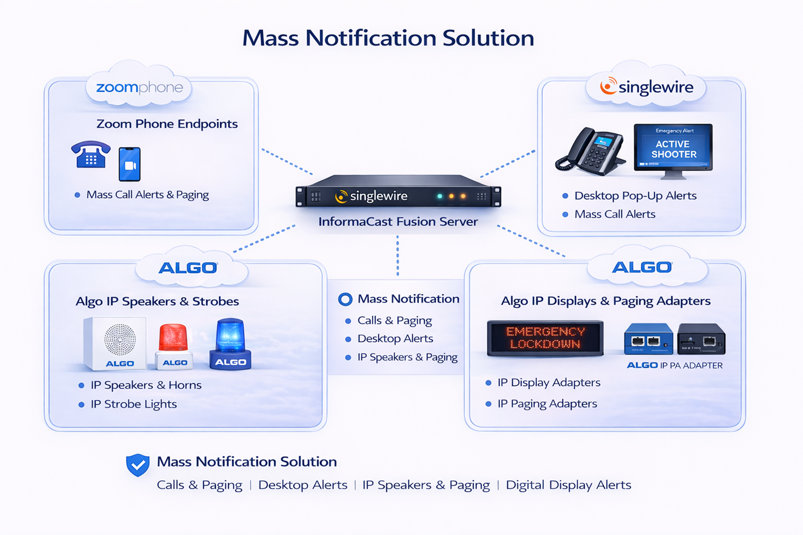

Slide 43
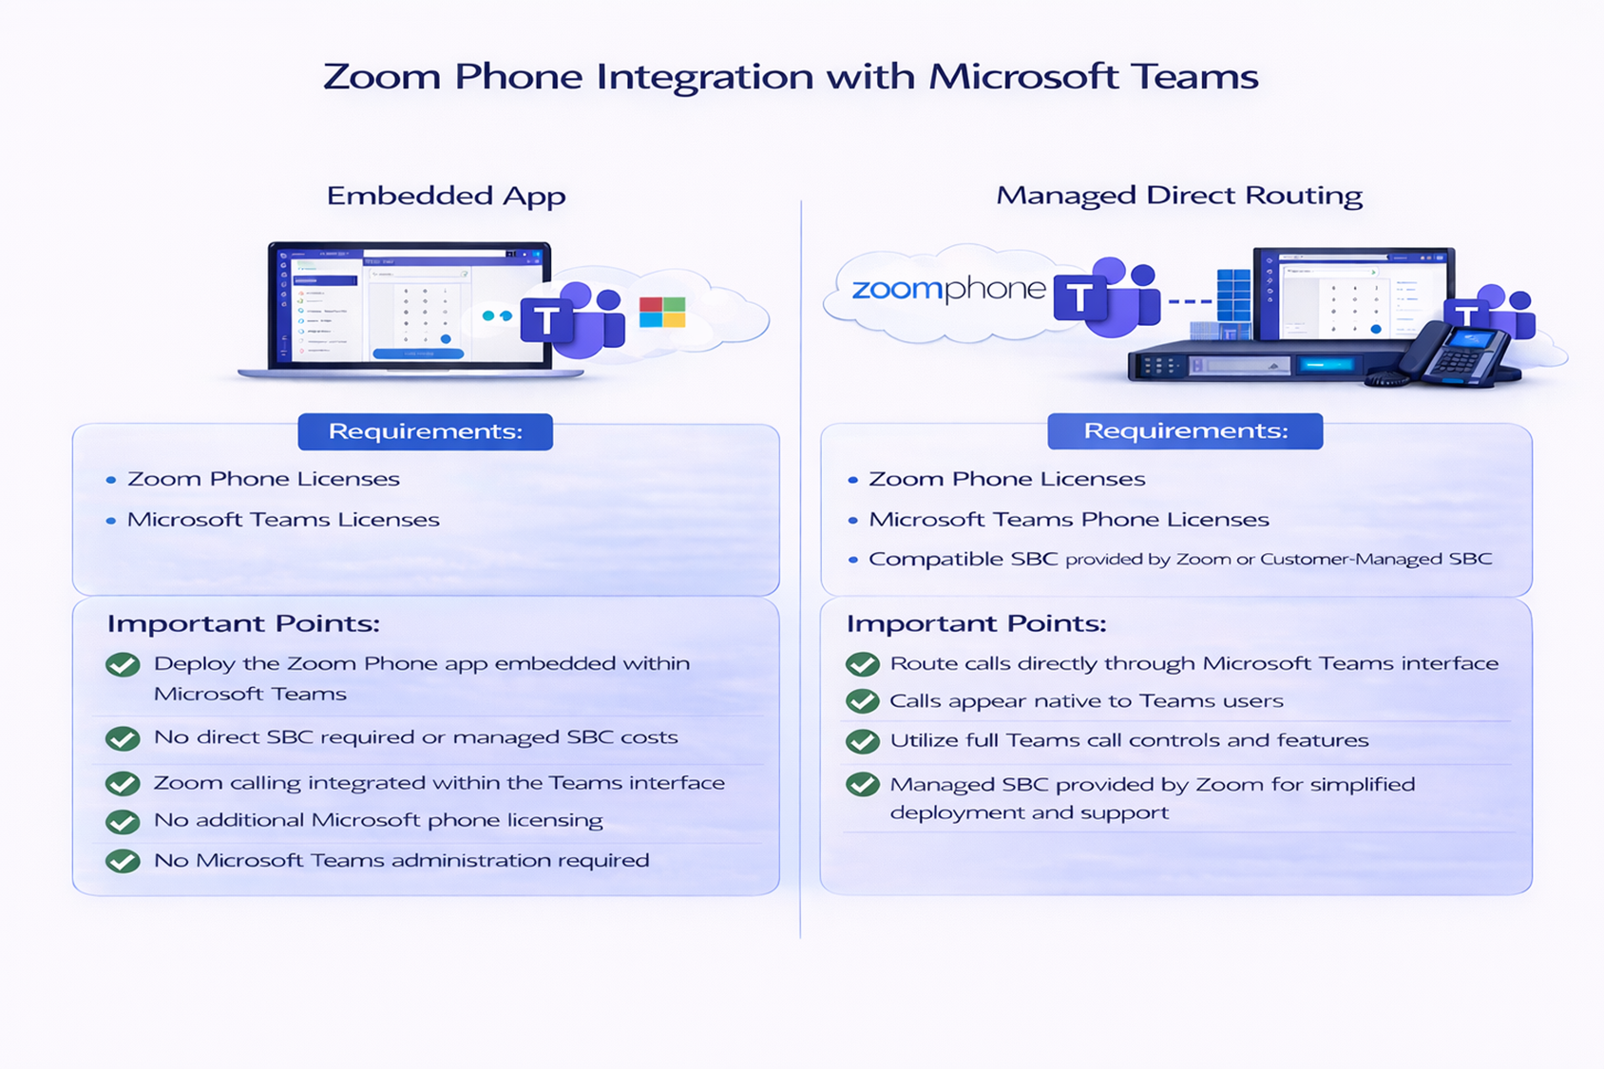

Slide 44
CloudConnect
Smarter Cloud Solutions, Seamless Support

Slide 45

What is CloudConnect?
All-in-one cloud solution for easy adoption and long-term success for UCaaS & CCaaS.

Slide 46
CloudConnect – Cloud Your Way
Seamless Implementation – Expert-led cloud setup.
Ongoing Optimization – Adapts as your business grows.
Reliable Support – Proactive troubleshooting & assistance.
Flexible Deployment – Choose the approach that fits you.
Future-Ready Solutions – Stay ahead with evolving cloud tech.
Customer-First Service – We’re your strategic IT partner.

Slide 47
CloudConnect Two Key Offerings
CloudPro
CloudSupport
Hands-On Cloud Implementation
We’ve got your back with expert guidance tailored to your needs.
Two Ways to Get Started
Advocacy Approach: We coach your players through the implementation for any UCaaS & CCaaS solution.
Full Implementation: We create and execute the game plan for you.
Reliable, Secure, Ongoing Support
Keeping your RingCentral or Zoom running smoothly.
MACs – Includes moves, adds, and changes (7 AM - 5 PM PST).
After-Hours Support – Includes 30 min free, then reduced rates.
Advanced Tasks – Discounts on call flows, setups, and integrations.
SLA Guarantees – 4-hour standard, 30-min emergency response.
Portal Access – Track tickets, updates, and history.

Slide 48
CloudSupport - SLA Matrix
Priority Level | Issue Type | Response Time | Resolution Time Target | Action
Priority 1 (Critical) | Service outage (Zoom/RingCentral platform-wide issue) | 15 minutes | N/A | Troubleshoot; Escalate with Executive Alignment to ensure Strategic Resolution
Priority 2 (High) | Significant service degradation, multiple users affected, account/login issues | 1 hour | 1 business day | Identify and Troubleshoot issues; Escalating, if necessary, with Executive Alignment to Drive a Timely and Effective Resolution
Priority 3 (Normal) | General issues, minor functionality problems, 'how-to' questions | 4 hours | 3 business days | Provide Tier 1 support & guidance

